Slide 1
﻿Learning Filter Pruning Criteria for ﻿for Deep Convolutional Neural Networks Acceleration
﻿Yang He，Yuhang Ding，Ping Liu，Linchao Zhu，Hanwang Zhang， Yi Yang

Slide 2
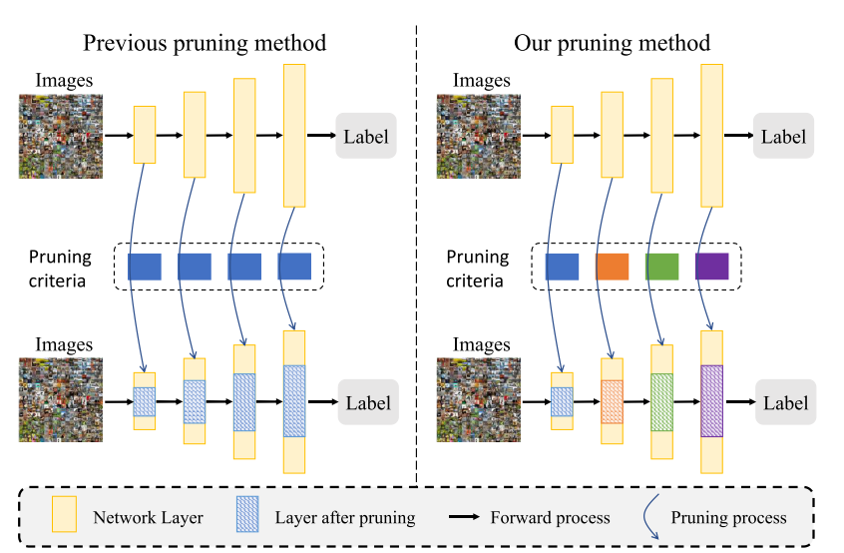
Introduction
Previous pruning drawback:
Failed to ﻿consider the variety of filter distribution across layers
﻿Failed to consider that all the layers in the network collaboratively make the final prediction
Contribution
﻿They propose an effective learning frame-work, Learning Filter Pruning Criteria (LFPC). This framework can learn
to select the most appropriate pruning
criteria for each functional layer.
They propose Differentiable Criteria
Sampler (DCS) can be trained end-to-end
and consider all the layers concurrently
during pruning.

Slide 3
Related work
﻿Weight-based Criteria
﻿Utilize the weights of the filters to determine the importance of the filter.
﻿Activation-based Criteria.
﻿Utilize the training data and filter activations to determine the pruned filters.
﻿Greedy and One-shot Pruning.
﻿Greedy pruning, or oracle pruning, means the pruning and retraining should be operated for multiple times.
﻿In contrast, one-shot pruning prunes the network once and retrained once to recover the accuracy.
﻿Other Pruning and Searching Methods.
﻿Reinforcement Learning or Meta-Learning.

Slide 4
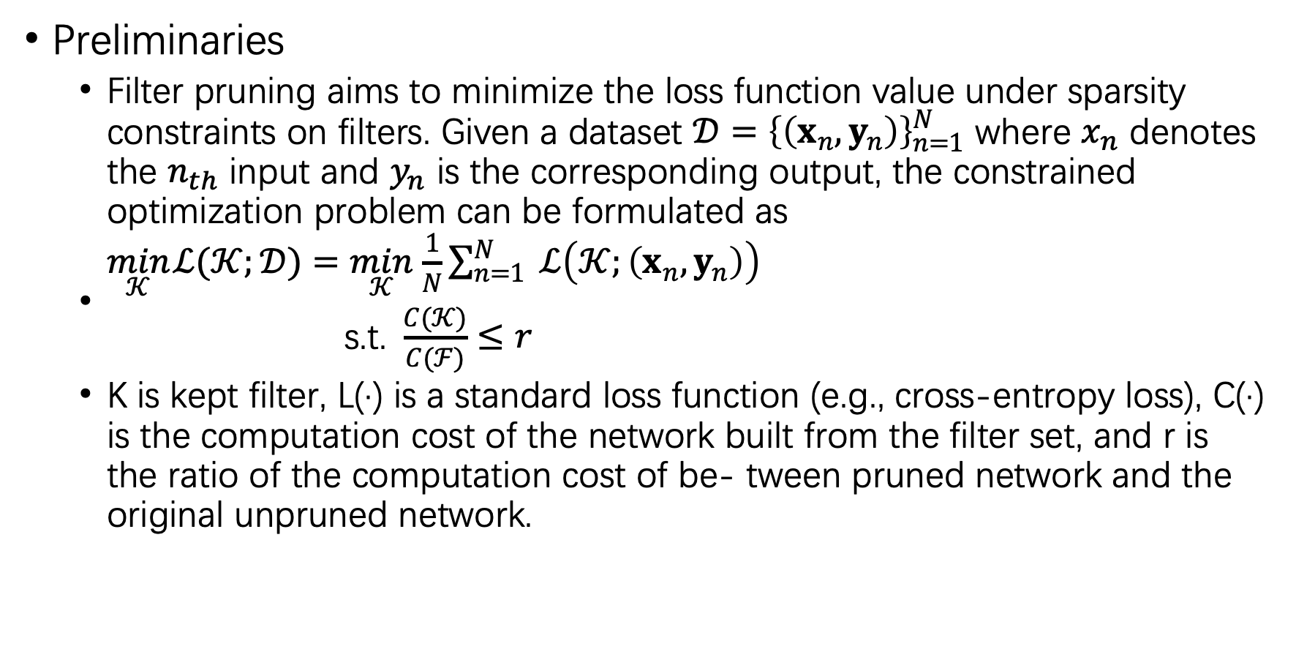
﻿Methodology
﻿Preliminaries
﻿﻿Filter pruning aims to minimize the loss function value under sparsity constraints on filters. Given a dataset $𝒟={\left\{\left(x_{n},y_{n}\right)\right\}}_{n=1}^{N}$ where $x_{n}$ denotes the $n_{th}$ input and $y_{n}$ is the corresponding output, the constrained optimization problem can be formulated as
$\begin{aligned}\min_{𝒦} ℒ(𝒦;𝒟)=\min_{𝒦} \frac{1}{N}\sum_{n=1}^{N}{ }ℒ\left(𝒦;\left(x_{n},y_{n}\right)\right) \\ \text{s}\text{.}\text{t}\text{. }\frac{C(𝒦)}{C(ℱ)}≤r\end{aligned}$
﻿K is kept filter, ﻿L(·) is a standard loss function (e.g., cross-entropy loss), C(·) is the computation cost of the network built from the filter set, and r is the ratio of the computation cost of be- tween pruned network and the original unpruned network.

Slide 5
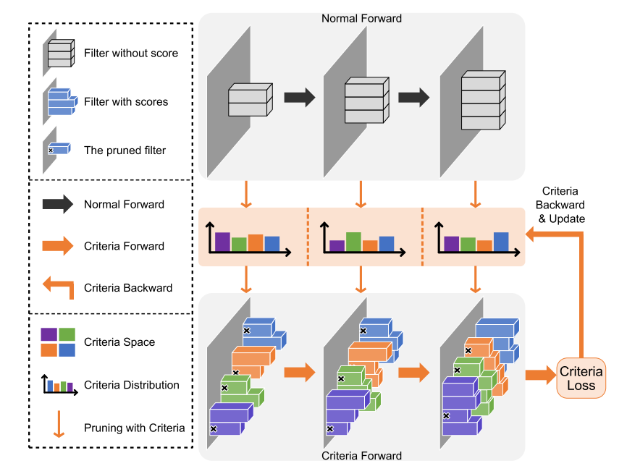
﻿Learning Filter Pruning Criteria
﻿Criteria forward and backward in the network. Grey boxes are the normal filters. The probability distribution of criteria for three layers are initialized, as shown in the big orange shadow. After pruning with four criteria, we obtain four “pruned versions” for every layer, which are denoted as boxes in purple, green, orange, and blue color. These filters are utilized to conduct criteria forward. Then we get the criteria loss on the validation set to update the “criteria distribution”.

Slide 6
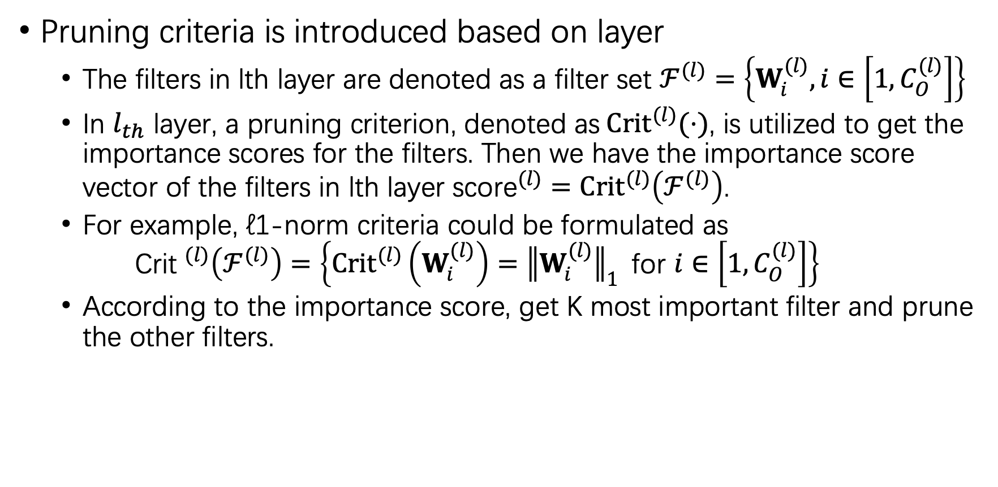
﻿Pruning Criteria
﻿Pruning criteria is introduced based on layer
The filters in lth layer are denoted as a filter set $ℱ^{(l)}=\left\{W_{i}^{(l)},i∈\left[1,C_{O}^{(l)}\right]\right\}$
In $l_{th}$ layer, a pruning criterion, denoted as${Crit}^{(l)}(⋅)$, is utilized to get the importance scores for the filters. Then we have the importance score vector of the filters in lth layer ${\text{score}}^{(l)}={Crit}^{(l)}\left(ℱ^{(l)}\right)$.
For example, ℓ1-norm criteria could be formulated as
$${\text{Crit} }^{(l)}\left(ℱ^{(l)}\right)=\left\{{Crit}^{(l)}\left(W_{i}^{(l)}\right)={∥W_{i}^{(l)}∥}_{1} \text{for} i∈\left[1,C_{O}^{(l)}\right]\right\}$$
﻿According to the importance score, get K most important filter and prune the other filters.

Slide 7
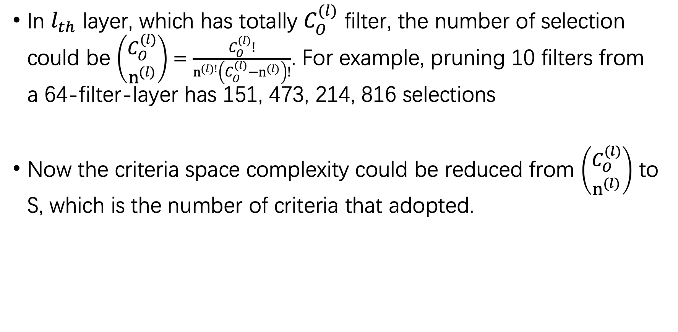
﻿Criteria Space Complexity
In $l_{th}$ layer, ﻿which has totally $C_{O}^{(l)}$ filter, ﻿the number of selection could be $\left(\begin{aligned}C_{O}^{(l)} \\ n^{(l)}\end{aligned}\right)=\frac{C_{O}^{(l)}!}{n^{(l)!}\left(C_{O}^{(l)}−n^{(l)}\right)!}$. ﻿For example, pruning 10 filters from a 64-filter-layer has 151, 473, 214, 816 selections
﻿Now the criteria space complexity could be reduced from $\left(\begin{aligned}C_{O}^{(l)} \\ n^{(l)}\end{aligned}\right)$ to S, which is the number of criteria that adopted.

Slide 8
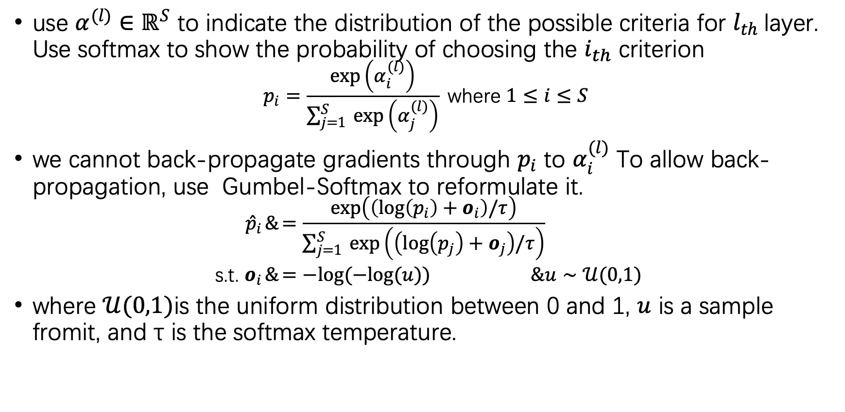
﻿Differentiable Criteria Sampler Assuming
use $α^{(l)}∈ℝ^{S}$ to indicate the distribution of the possible criteria for $l_{th}$layer. Use softmax to show the probability of choosing the $i_{th}$ criterion
$$p_{i}=\frac{\exp\left(α_{i}^{(l)}\right)}{\sum_{j=1}^{S}{ }exp\left(α_{j}^{(l)}\right)} \text{where} 1≤i≤S$$
we cannot back-propagate gradients through $p_{i}$ to $α_{i}^{(l)}$ To allow back-propagation, use Gumbel-Softmax to reformulate it.
$$\begin{aligned}{\hat{p}}_{i}&=\frac{\exp\left(\left(log\left(p_{i}\right)+o_{i}\right)/τ\right)}{\sum_{j=1}^{S}{ }exp\left(\left(log\left(p_{j}\right)+o_{j}\right)/τ\right)} \\ \text{s}\text{.}\text{t}\text{. }o_{i}&=−log(−log(u))&u∼𝒰(0,1)\end{aligned}$$
where $𝒰(0,1)$is the uniform distribution between 0 and 1, $u$ is a sample fromit, and τ is the softmax temperature.

Slide 9
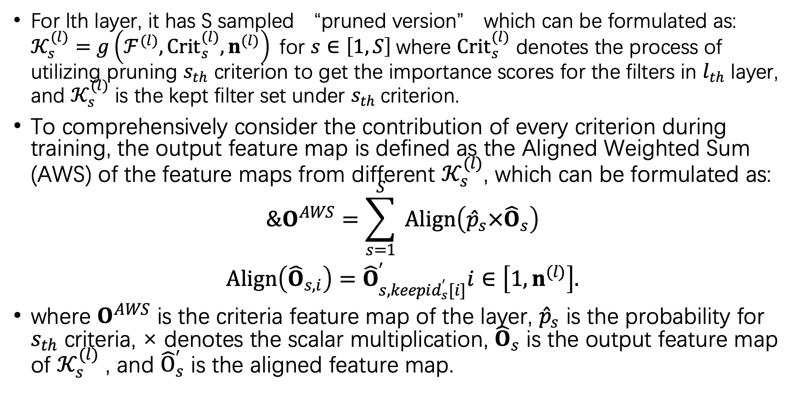
﻿Criteria Forward
For lth layer, it has S sampled “pruned version” which can be formulated as: $𝒦_{s}^{(l)}=g\left(ℱ^{(l)},{Crit}_{s}^{(l)},n^{(l)}\right) \text{for} s∈\left[1,S\right]$where ${Crit}_{s}^{(l)}$ denotes the process of utilizing pruning $s_{th}$ criterion to get the importance scores for the filters in $l_{th}$ layer, and $𝒦_{s}^{(l)}$ is the kept filter set under $s_{th}$criterion.
To comprehensively consider the contribution of every criterion during training, the output feature map is defined as the Aligned Weighted Sum (AWS) of the feature maps from different $𝒦_{s}^{(l)}$, which can be formulated as:
$$\begin{aligned}&O^{AWS}=\sum_{s=1}^{S}{ }Align\left({\hat{p}}_{s}×{\hat{O}}_{s}\right) \\ Align\left({\hat{O}}_{s,i}\right)={\hat{O}}_{s,keepid_{s}^{′}[i]}^{′}i∈\left[1,n^{(l)}\right].\end{aligned}$$
where $O^{AWS}$ is the criteria feature map of the layer, ${\hat{p}}_{s}$ is the probability for $s_{th}$ criteria, × denotes the scalar multiplication, ${\hat{O}}_{s}$ is the output feature map of $𝒦_{s}^{(l)}$ , and ${\hat{O}}_{s}^{′}$ is the aligned feature map.

Slide 10
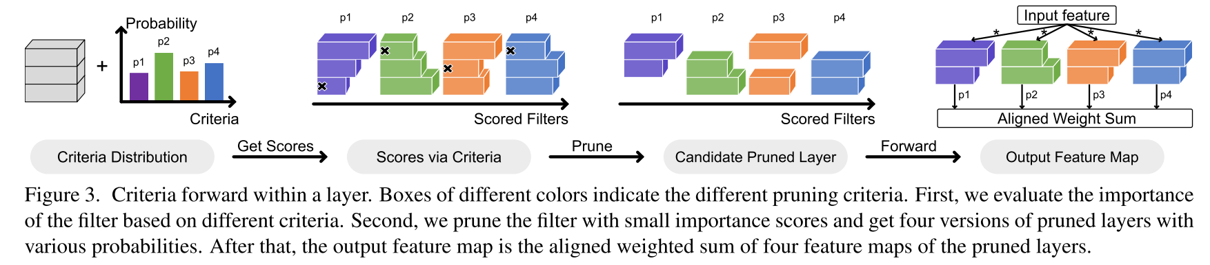
Criteria Forward

Slide 11
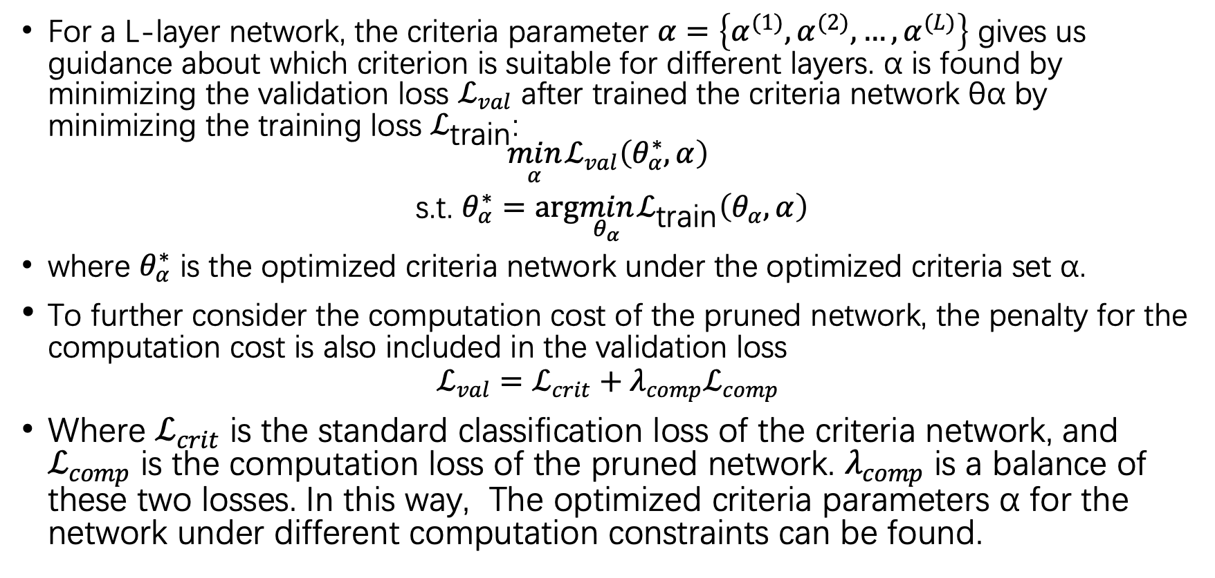
﻿Training Objectives.
For a L-layer network, the criteria parameter $α=\left\{α^{(1)},α^{(2)},…,α^{(L)}\right\}$ gives us guidance about which criterion is suitable for different layers. α is found by minimizing the validation loss $ℒ_{val}$ after trained the criteria network θα by minimizing the training loss $ℒ_{\text{train}}$:
$$\begin{aligned}\min_{α} ℒ_{val}\left(θ_{α}^{∗},α\right) \\ \text{s}\text{.}\text{t}\text{. }θ_{α}^{∗}=arg\min_{θ_{α}} ℒ_{\text{train}}\left(θ_{α},α\right)\end{aligned}$$
where $θ_{α}^{∗}$ is the optimized criteria network under the optimized criteria set α.
﻿To further consider the computation cost of the pruned network, the penalty for the computation cost is also included in the validation loss
$$ℒ_{val}=ℒ_{crit}+λ_{comp}ℒ_{comp}$$
Where $ℒ_{crit}$ is the standard classification loss of the criteria network, and $ℒ_{comp}$ is the computation loss of the pruned network. $λ_{comp}$ is a balance of these two losses. In this way, The optimized criteria parameters α for the network under different computation constraints can be found.

Slide 12
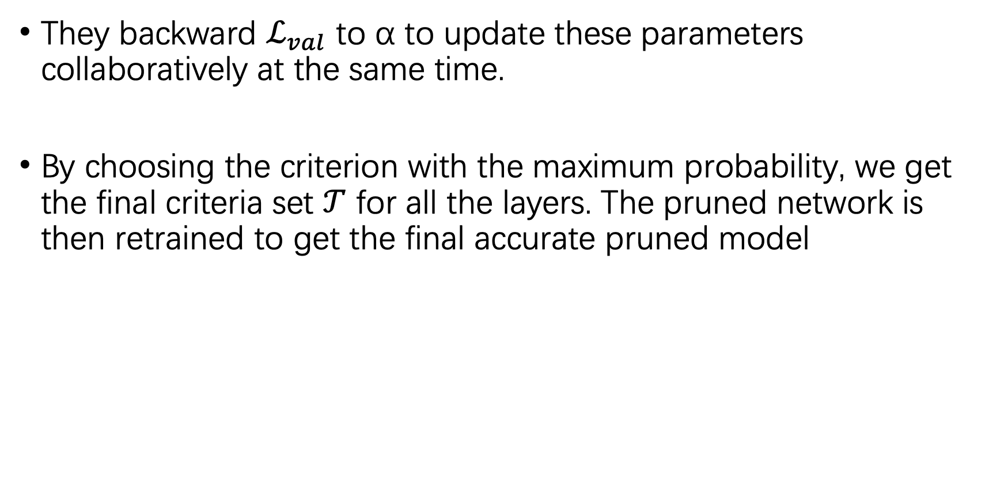
﻿Criteria Backward & ﻿After DCS Training
They backward $ℒ_{val}$ to α to update these parameters collaboratively at the same time.
﻿By choosing the criterion with the maximum probability, ﻿we get the final criteria set $𝒯$ for all the layers. ﻿The pruned network is then retrained to get the final accurate pruned model

Slide 13
﻿Experiments
﻿Datasets : ﻿CIFAR-10, CIFAR-100 and ILSVRC-2012.
﻿Architecture Setting : ﻿ResNet has less redundancy than VGGNet and accelerating ResNet is more difficult than accelerating VGGNet. Therefore, they focus on pruning the challenging ResNet.
﻿Normal Training Setting : using the unpruned network as benchmark
﻿DCS training Setting : using ﻿ℓ1-norm, ℓ2-norm and geometric median based criteria.
﻿Pruning Setting. After training DCS, we prune the network with the optimized criteria and fine-tune the network with the full training set.

Slide 14
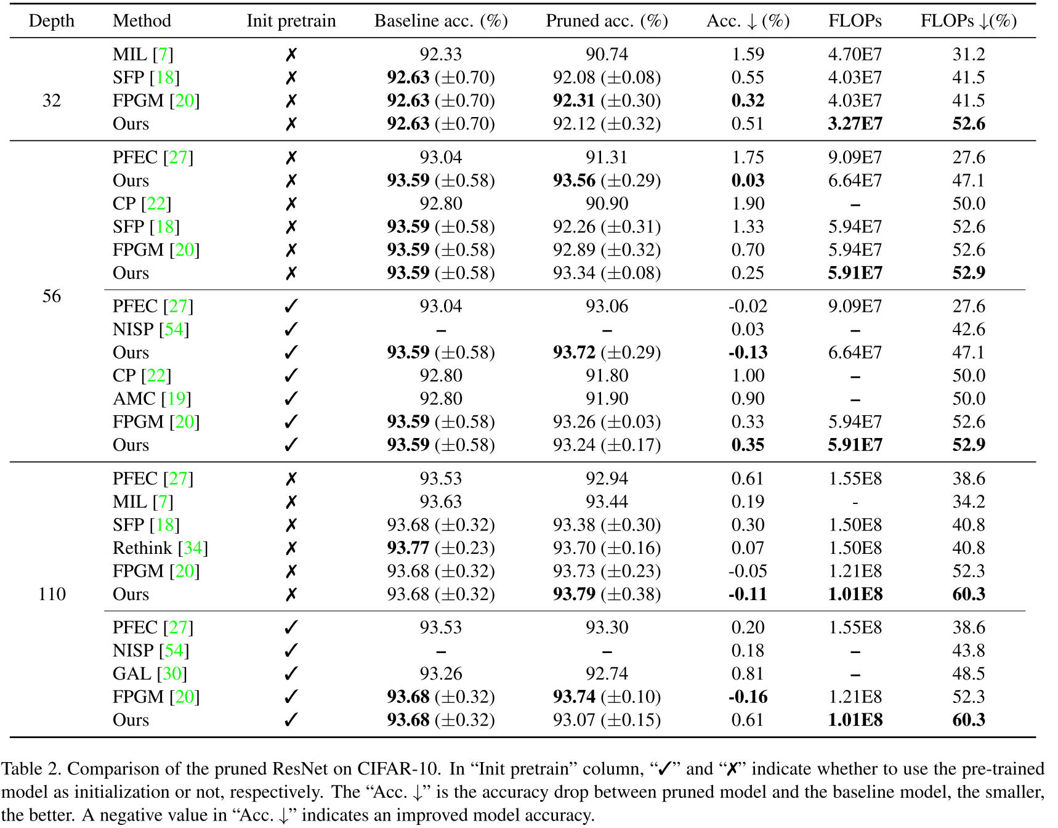
Experiments

